Slide 1
Require PO Overview when Submitting Invoices
Bridge Design Section

Slide 2
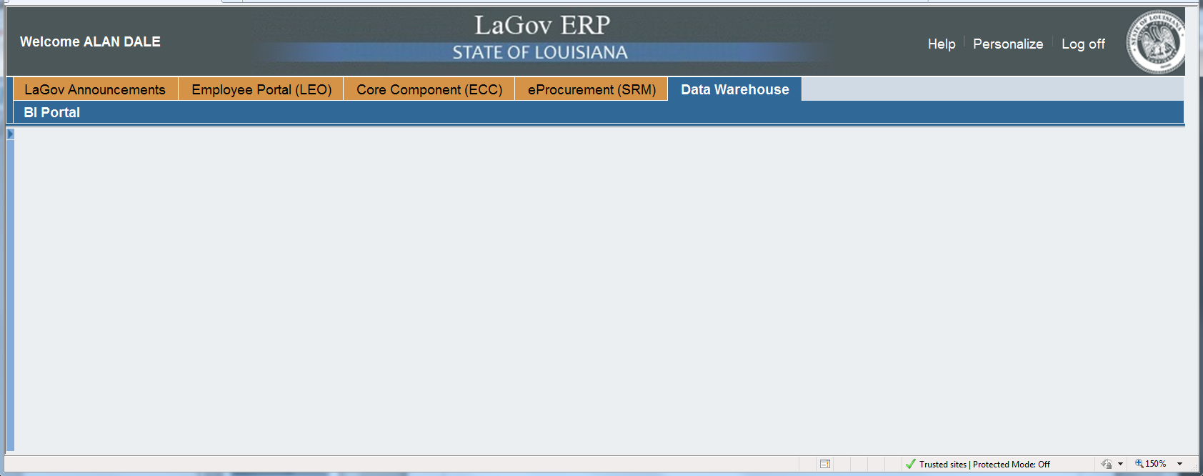
From LaGov go to Data Warehouse (data is from previous night run)

Slide 3
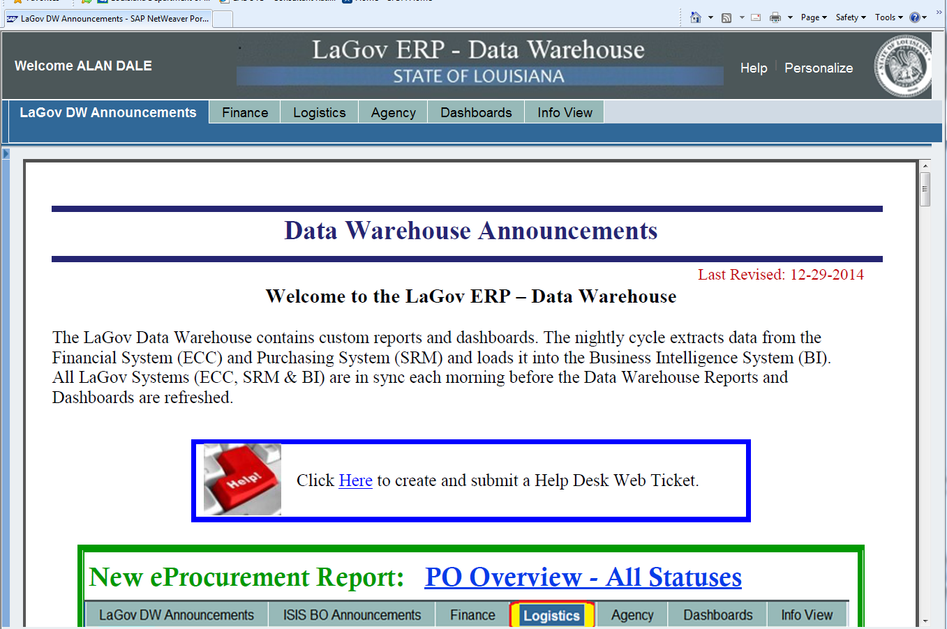
Click on Info View

Slide 4
Click on Launchpad (Infoview)

Slide 5
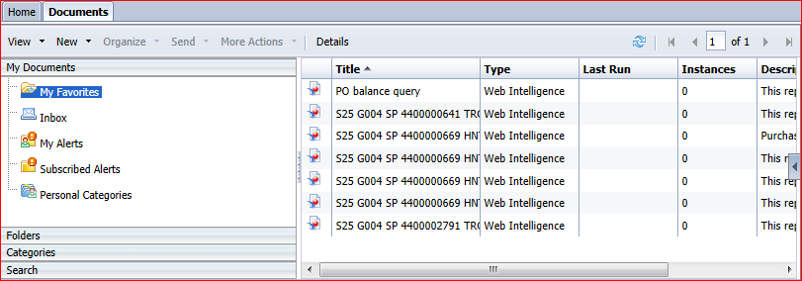
Click on Folder

Slide 6
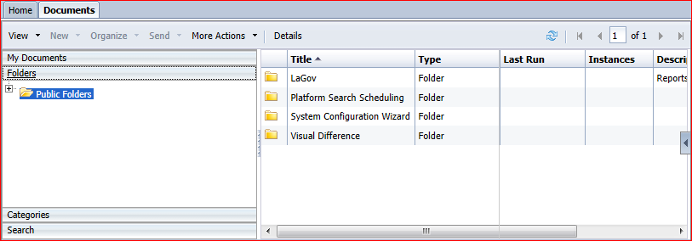
Click on Public Folders

Slide 7
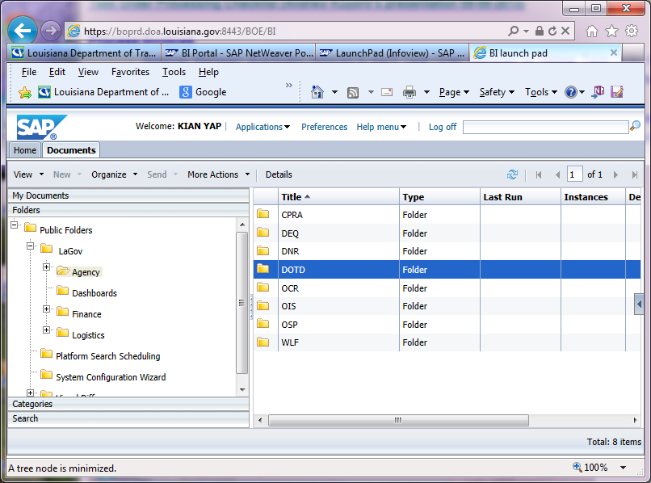
Click on LaGov – Agency - DOTD

Slide 8
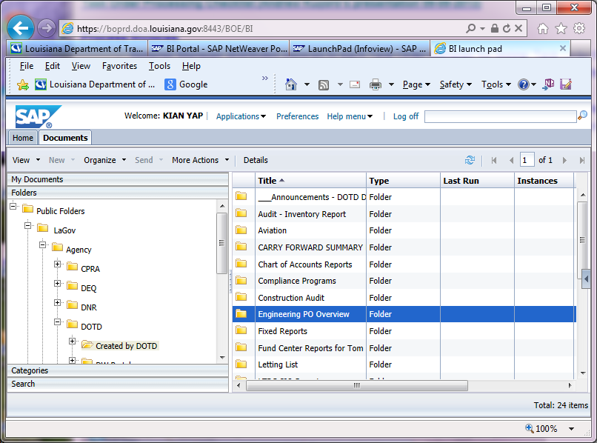
Click on Created by DOTD – Engineering PO Overview

Slide 9
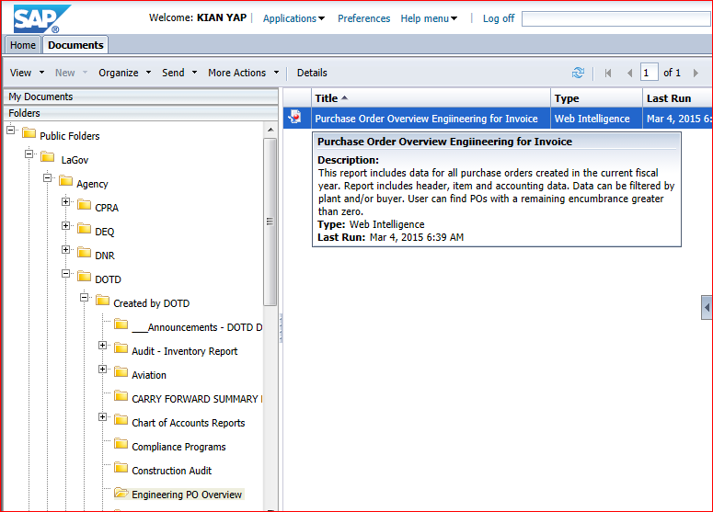
Click on Purchase Order Overview Engineering for Invoice

Slide 10
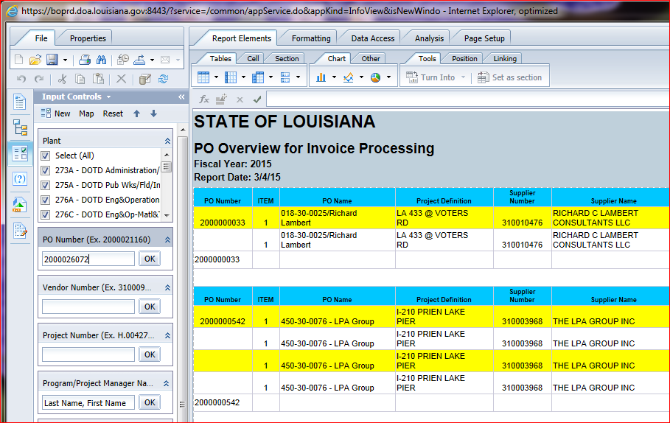
Click on Input Controls – Key in the PO number (10 digits), then click OK

Slide 11
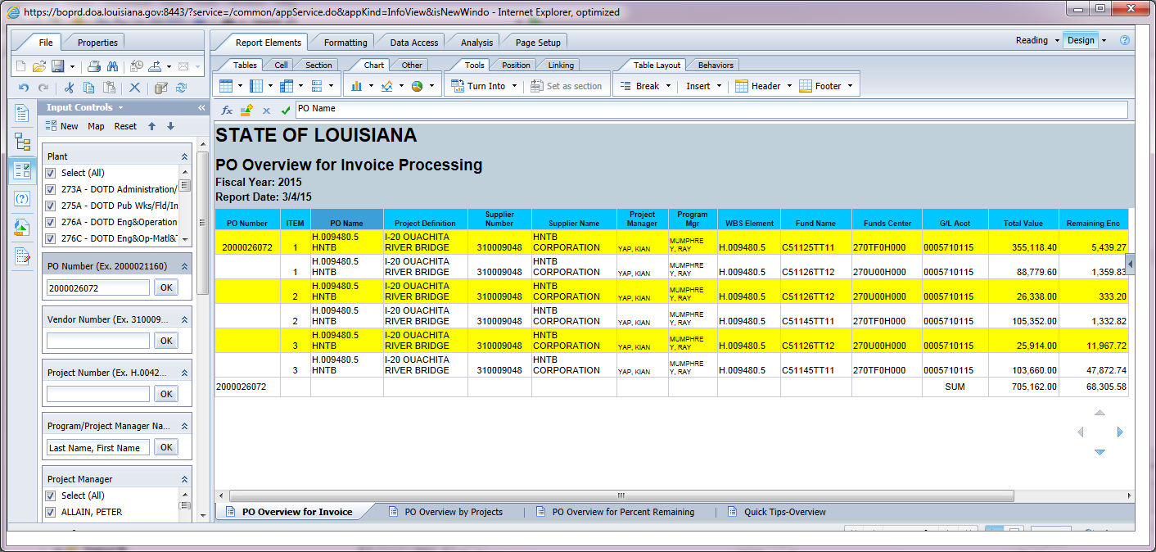
Make sure you are on “PO Overview for Invoice” Tab

Slide 12
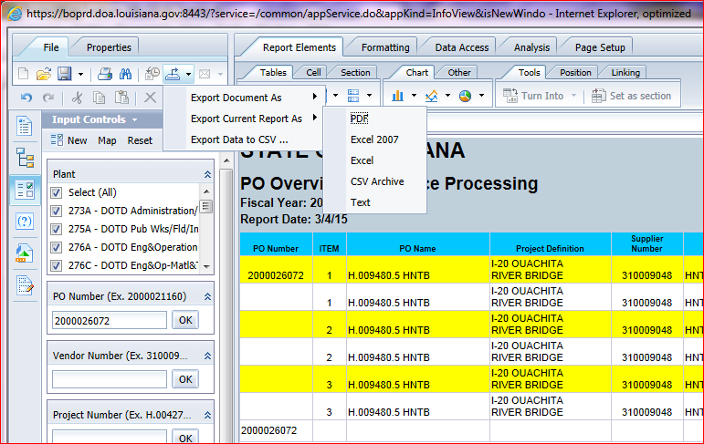
Click on Export - Export Current Report As - PDF

Slide 13
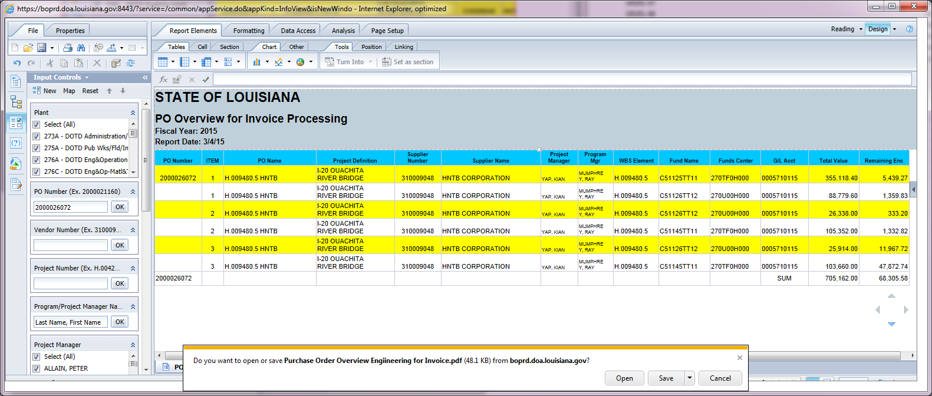
Click on Open

Slide 14
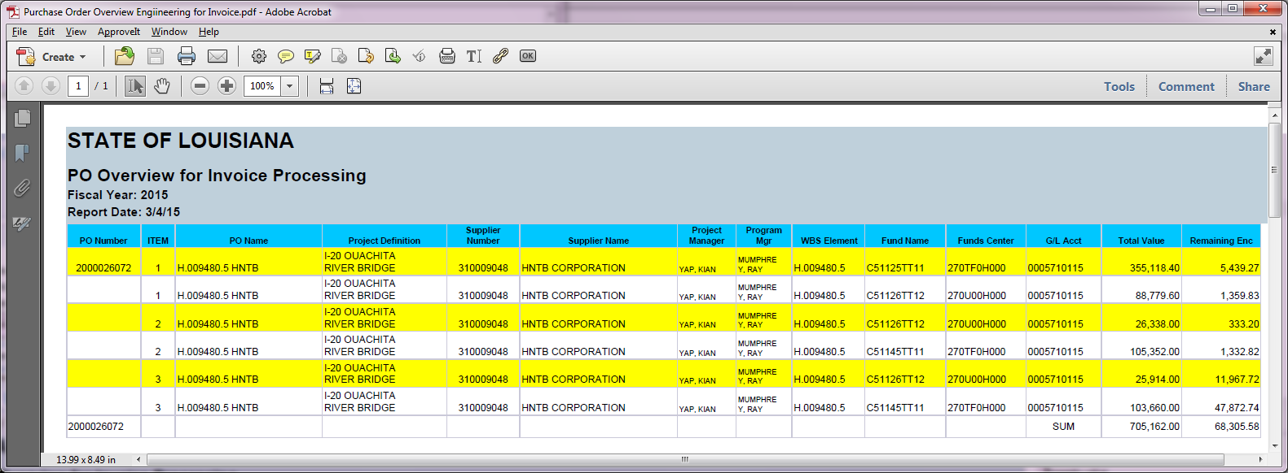
Click on File – Print… (PDF should have only 1 or 2 pages)

Slide 15
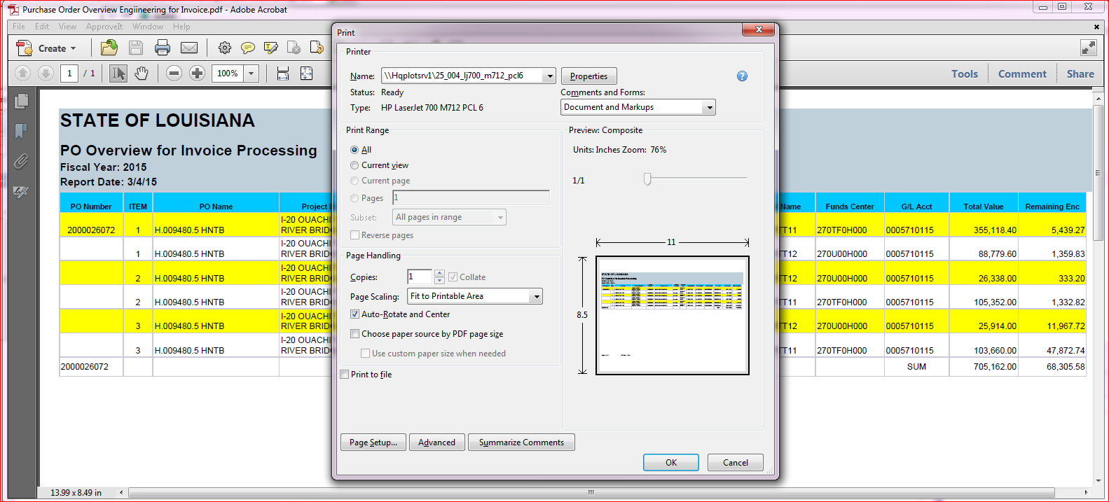
Click OK to print PDF submit printout with approved invoice

